Slide 1
More on MongoDB

Slide 2
Outline
Schema Design
Linking
Embedding
Indexing
Aggregation Pipelines

Slide 3
Schema Design

Slide 4
RDBMS |  | MongoDB
Database | ➜ | Database
Table | ➜ | Collection
Row | ➜ | Document
Index | ➜ | Index
Join | ➜ | Embedded Document
Foreign Key | ➜ | Reference

Slide 5
Mongo is basically schema-free
The purpose of schema in SQL is for meeting the requirements of tables and SQL implementation
Every “row” in a database “table” is a data structure, much like a “struct” in C, or a “class” in Java. A table is then an array (or list) of such data structures
So what we design in mongoDB is basically same way how we design a compound data type binding in JSON

Slide 6
There are some patterns
Embedding
Linking/referencing

Slide 7
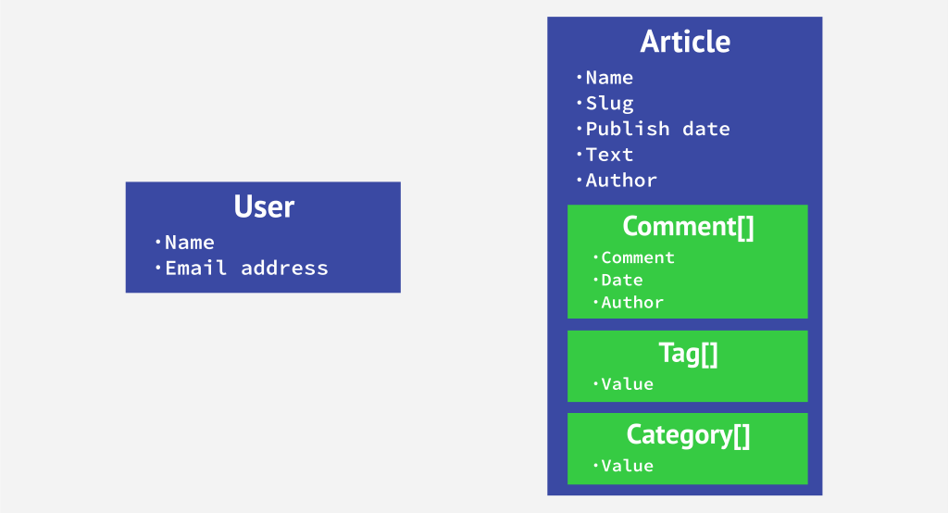
Embedding & Linking

Slide 8
One to One relationship
zip = {
_id: 35004,
city: “ACMAR”,
loc: [-86, 33],
pop: 6065,
State: “AL”
}
Council_person = {
zip_id = 35004,
name: “John Doe",
address: “123 Fake St.”,
Phone: 123456
}
zip = {
_id: 35004 ,
city: “ACMAR”
loc: [-86, 33],
pop: 6065,
State: “AL”,
council_person: {
name: “John Doe",
address: “123 Fake St.”,
Phone: 123456
}
}

Slide 9
One to Many Relationship
Consider an e-commerce site that has a list of reviews for a product
A product has many reviews
One review is for one product

Slide 10
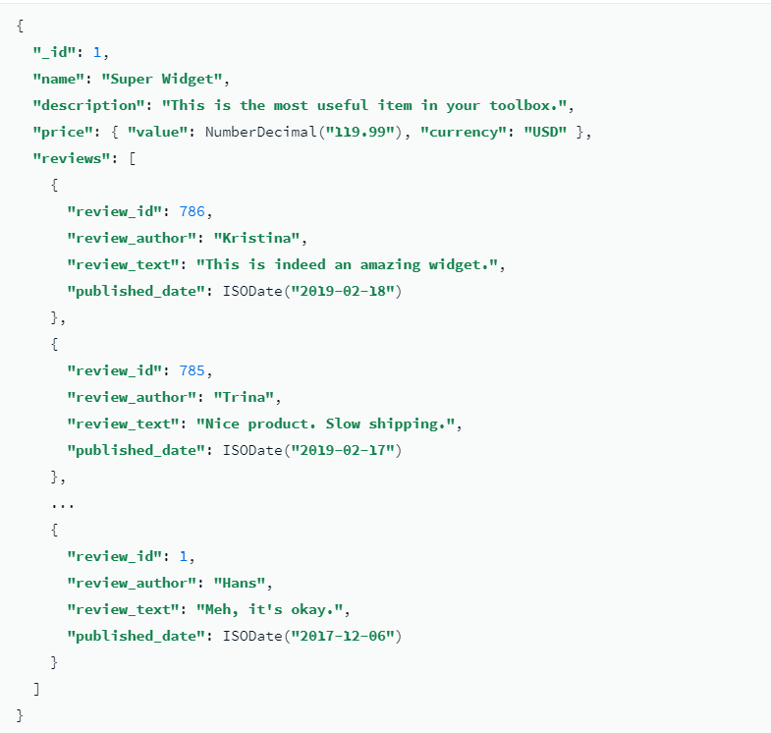
Embedding

Slide 11
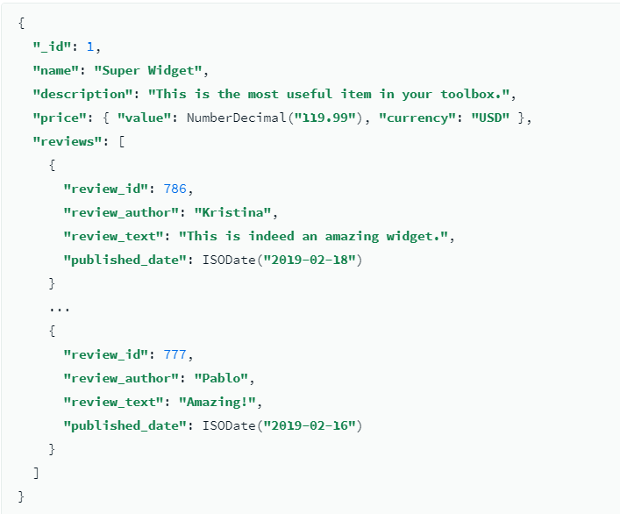
Linking/Referencing
Instead of storing all of the reviews with the product, you can split the collection into two collections:

Slide 12
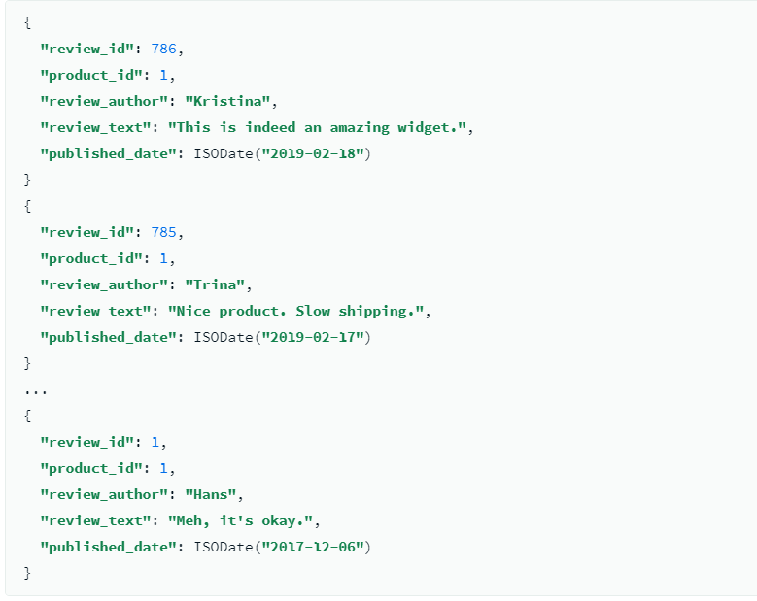

Slide 13
Linking vs. Embedding
Embedding is a bit like pre-joining data
Document level operations are easy for the server to handle
Embed when the “many” objects always appear with (viewed in the context of) their parents.
Linking when you need more flexibility

Slide 14
Many to many relationship
Can put relation in either one of the documents (linking in one of the documents)
Focus how data is accessed/queried

Slide 15
Example
Each patron may have multiple addresses
Each address belongs to one patron

Slide 16
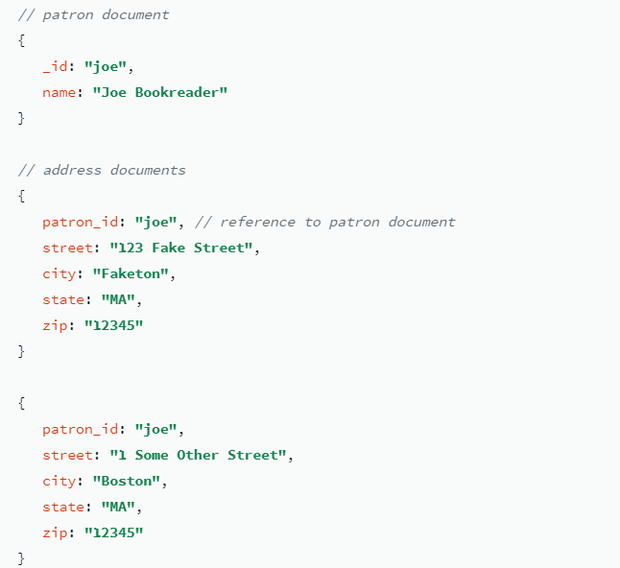
Linking

Slide 17
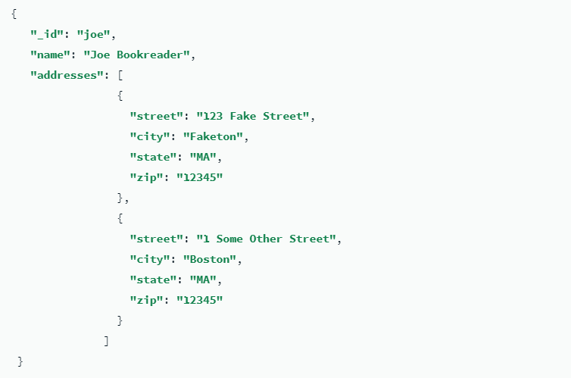
Embedding

Slide 18
Index in MongoDB

Slide 19
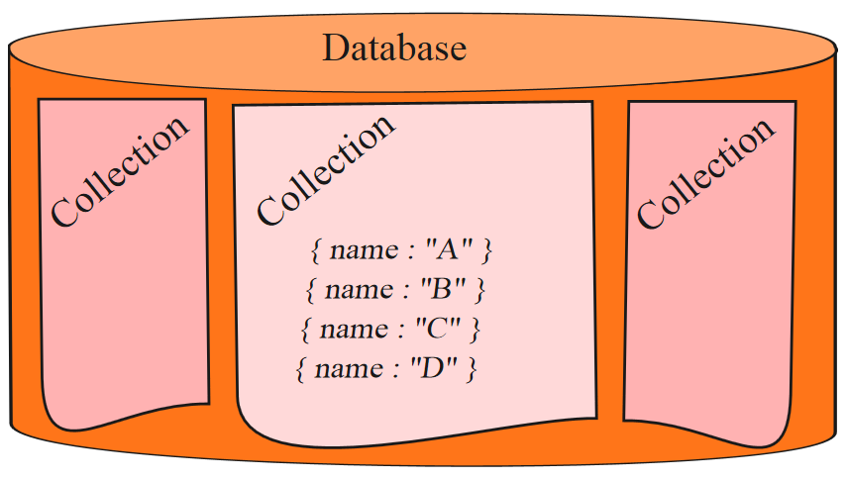

Before Index
What does database normally do when we query?
MongoDB must scan every document.
Inefficient because process large volume of data
db.users.find( { score: { “$lt” : 30} } )

Slide 20
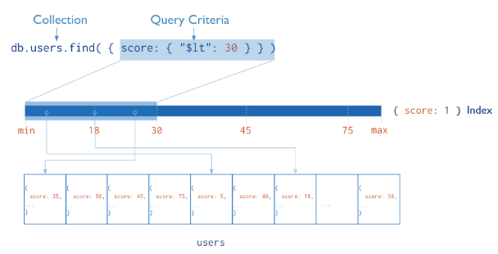
Definition of Index
Definition
Indexes are special data structures that store a small portion of the collection’s data set in an easy to traverse form.
Index
Diagram of a query that uses an index to select

Slide 21
Index in MongoDB
Operations
Creation index
db.users.ensureIndex( { score: 1 } )
Show existing indexes
db.users.getIndexes()
Drop index
db.users.dropIndex( {score: 1} )
Explain—Explain
db.users.find().explain()
Returns a document that describes the process and indexes
Hint
db.users.find().hint({score: 1})
Overide MongoDB’s default index selection

Slide 22
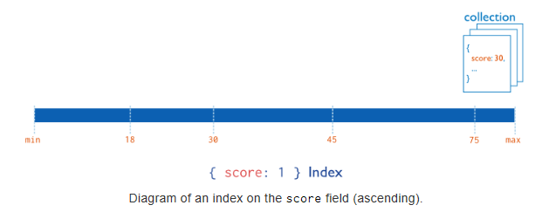
Index in MongoDB
Types
Single Field Indexes
Compound Field Indexes
Multikey Indexes
Single Field Indexes
db.users.ensureIndex( { score: 1 } )

Slide 23
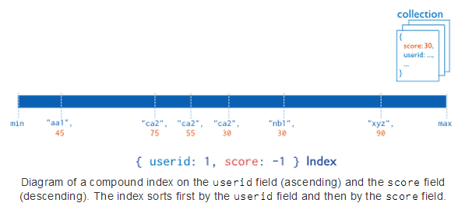
Index in MongoDB
Types
Single Field Indexes
Compound Field Indexes
Multikey Indexes
Compound Field Indexes
db.users.ensureIndex( { userid:1, score: -1 } )

Slide 24
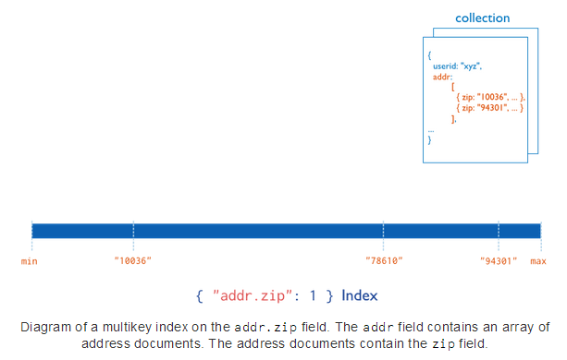
Index in MongoDB
Types
Single Field Indexes
Compound Field Indexes
Multikey Indexes
Multikey Indexes
db.users.ensureIndex( { addr.zip:1} )

Slide 25
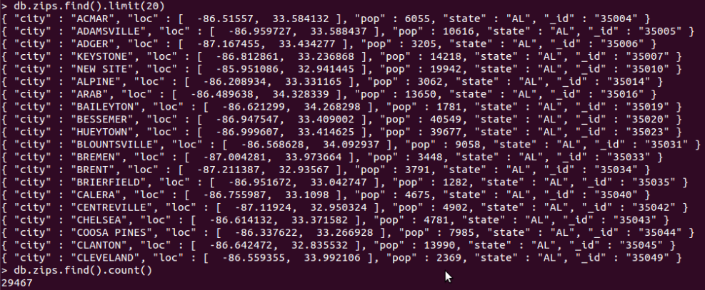
Demo of indexes in MongoDB
Import Data
Create Index
Single Field Index
Compound Field Indexes
Multikey Indexes
Show Existing Index
Hint
Single Field Index
Compound Field Indexes
Multikey Indexes
Explain
Compare with data without indexes

Slide 26

Demo of indexes in MongoDB
Import Data
Create Index
Single Field Index
Compound Field Indexes
Multikey Indexes
Show Existing Index
Hint
Single Field Index
Compound Field Indexes
Multikey Indexes
Explain
Compare with data without indexes

Slide 27
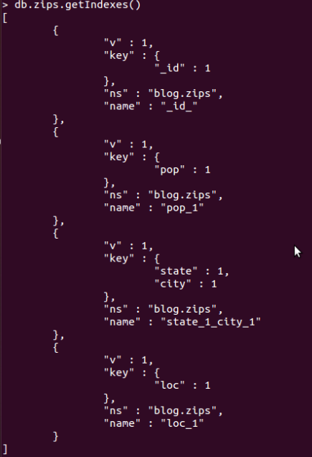
Demo of indexes in MongoDB
Import Data
Create Index
Single Field Index
Compound Field Indexes
Multikey Indexes
Show Existing Index
Hint
Single Field Index
Compound Field Indexes
Multikey Indexes
Explain
Compare with data without indexes

Slide 28
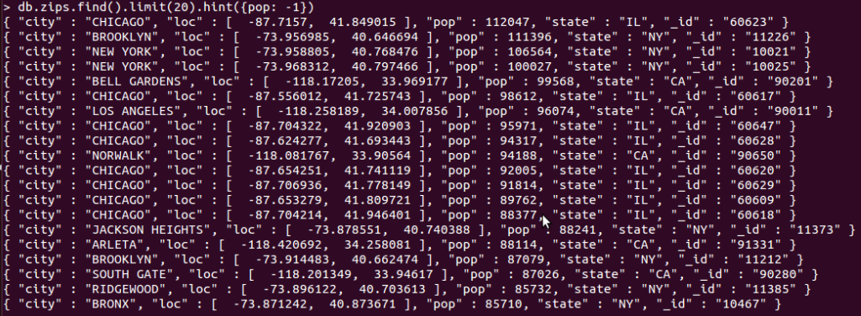
Demo of indexes in MongoDB
Import Data
Create Index
Single Field Index
Compound Field Indexes
Multikey Indexes
Show Existing Index
Hint
Single Field Index
Compound Field Indexes
Multikey Indexes
Explain
Compare with data without indexes

Slide 29
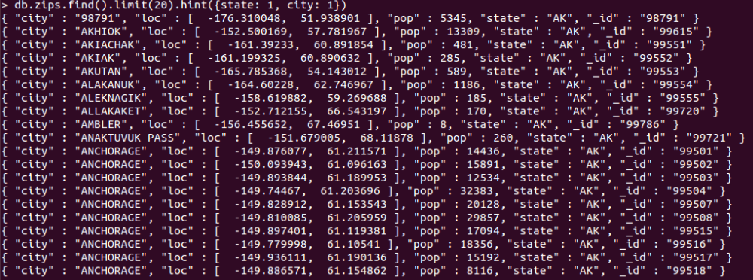
Demo of indexes in MongoDB
Import Data
Create Index
Single Field Index
Compound Field Indexes
Multikey Indexes
Show Existing Index
Hint
Single Field Index
Compound Field Indexes
Multikey Indexes
Explain
Compare with data without indexes

Slide 30
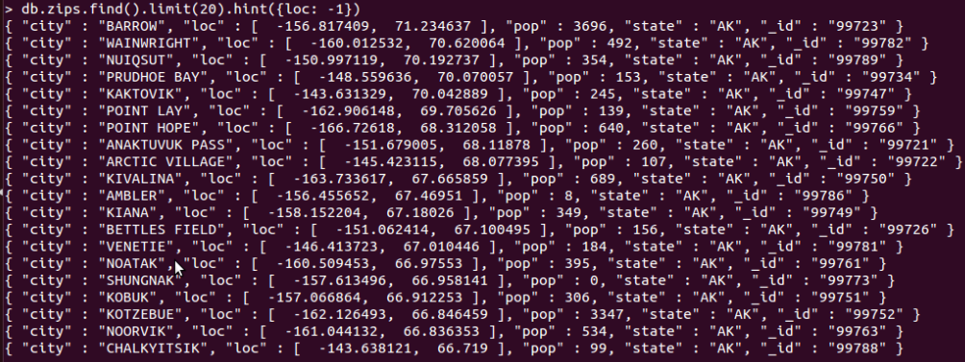
Demo of indexes in MongoDB
Import Data
Create Index
Single Field Index
Compound Field Indexes
Multikey Indexes
Show Existing Index
Hint
Single Field Index
Compound Field Indexes
Multikey Indexes
Explain
Compare with data without indexes

Slide 31
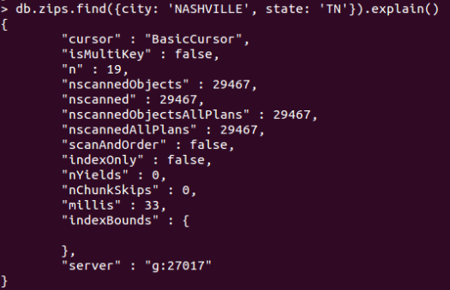
Demo of indexes in MongoDB
Import Data
Create Index
Single Field Index
Compound Field Indexes
Multikey Indexes
Show Existing Index
Hint
Single Field Index
Compound Field Indexes
Multikey Indexes
Explain
Compare with data without indexes

Slide 32
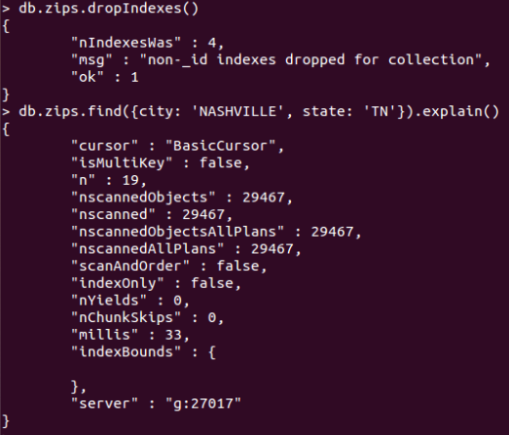
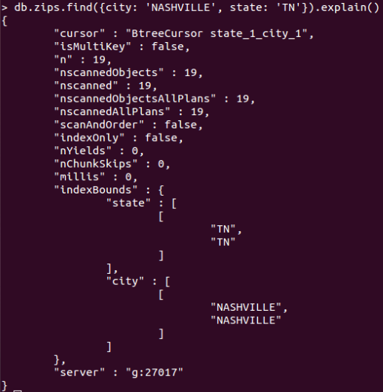
Demo of indexes in MongoDB
Import Data
Create Index
Single Field Index
Compound Field Indexes
Multikey Indexes
Show Existing Index
Hint
Single Field Index
Compound Field Indexes
Multikey Indexes
Explain
Compare with data without indexes
Without Index
With Index

Slide 33
Aggregation Pipelines

Slide 34
Aggregation
Operations that process data records and return computed results.
You can use aggregation operations to:
Group values from multiple documents together.
Perform operations on the grouped data to return a single result.
Analyze data changes over time.
Aggregations are used in MongoDB to analyze data and derive meaningful information out of it.

Slide 35
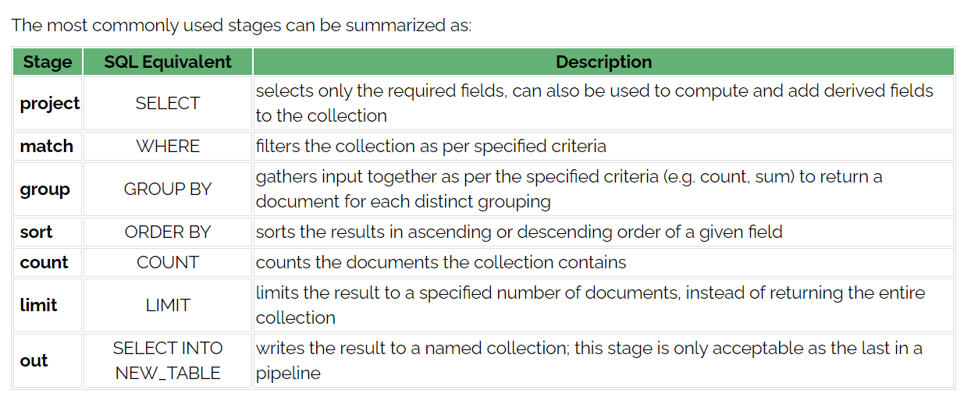
Pipelines
These are usually performed in various stages, and the stages form a pipeline – such that the output of one stage is passed on as input to the next stage.
Unwind: https://www.mongodb.com/docs/manual/reference/operator/aggregation/unwind/?_ga=2.179656098.787332207.1651156271-342768885.1647281736

Slide 36
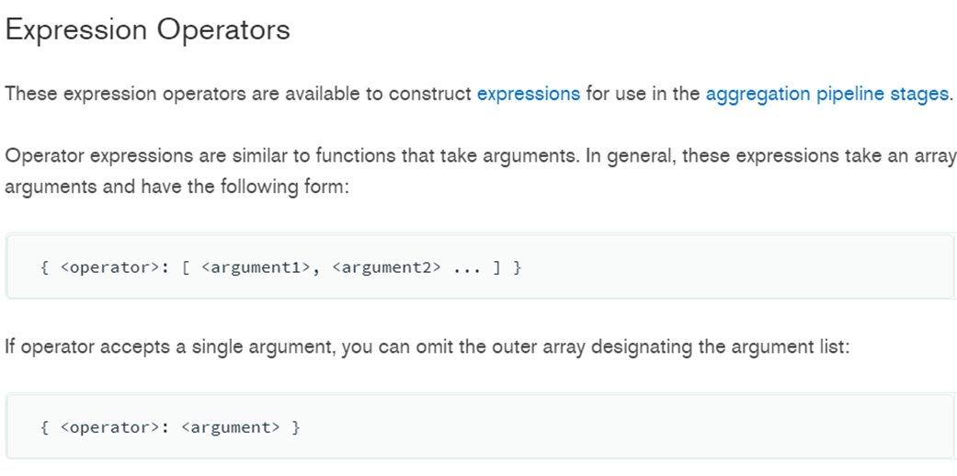
Pipelines:
Expression operators:
https://docs.mongodb.com/manual/reference/operator/aggregation/

Slide 37
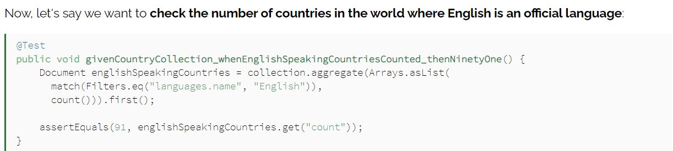
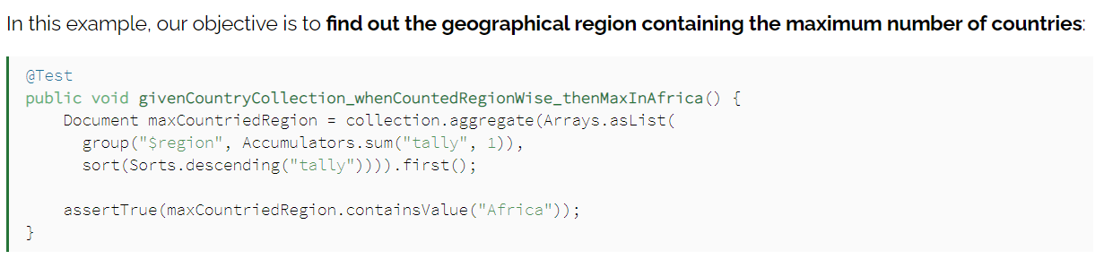
Pipelines:

Slide 38
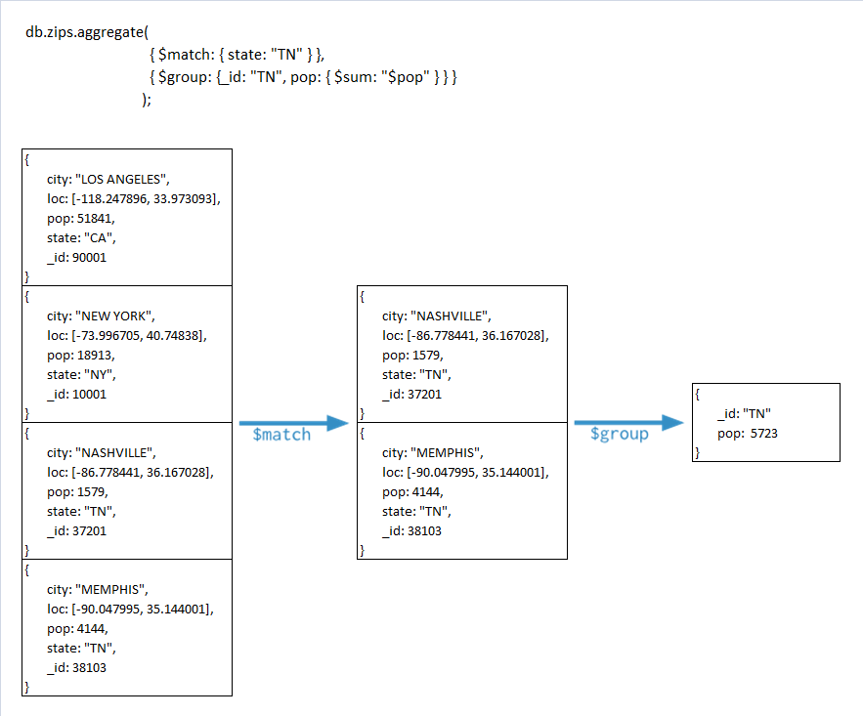

Slide 39
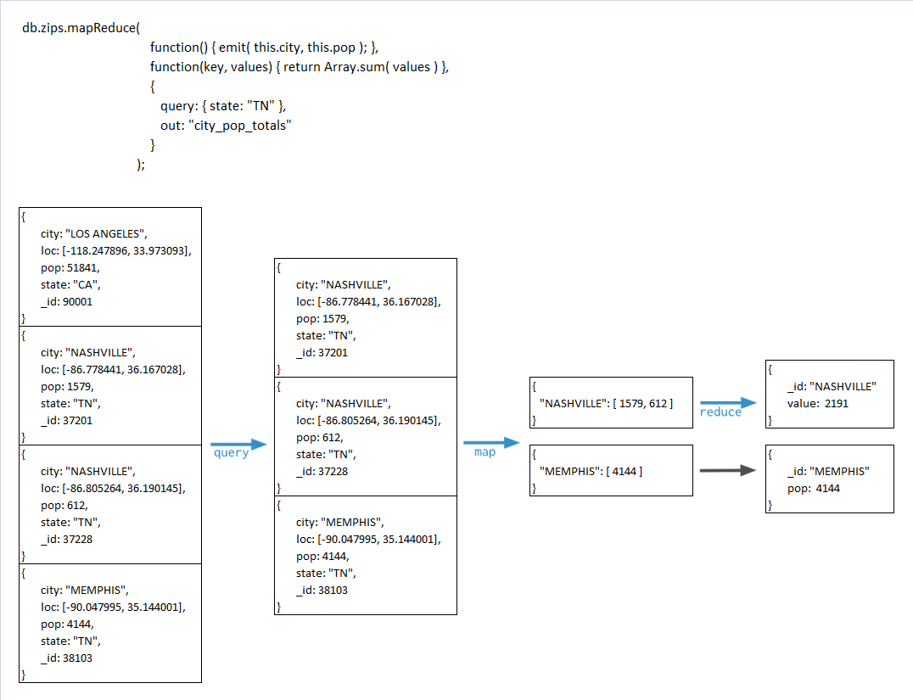

Slide 40
Single Purpose Aggregation Operations
Special purpose database commands:
returning a count of matching documents
returning the distinct values for a field
grouping data based on the values of a field.
Aggregate documents from a single collection.
Lack the flexibility and capabilities of the aggregation pipeline and map-reduce.

Slide 41
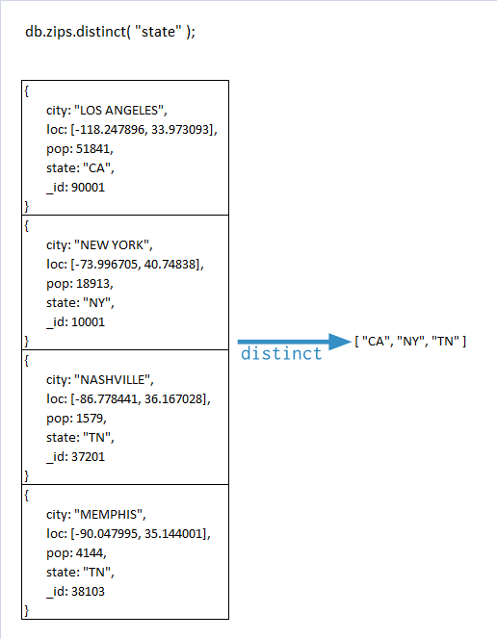

Slide 42
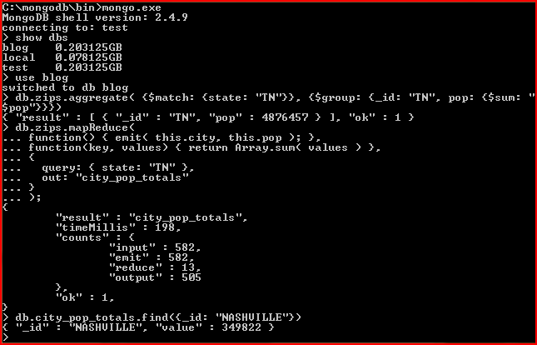

Slide 43
